Slide 1


Lisdexmfetamine for MA dependence:
Baseline characteristics of the LiMA study sample.
Brendan Clifford PhD
St Vincent’s Hospital Sydney, NDARC & NCCRED on behalf of LiMA investigators

Slide 2




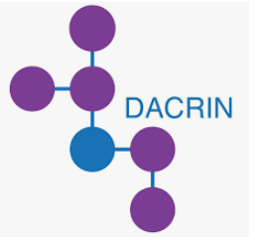





LiMA Investigator Team
    Nadine Ezard
    Adrian Dunlop
    Will Liaw
    Mike McDonough
    Robert Ali
    Jason White
    Rebecca McKetin
    Raimondo Bruno
    Andrew Carr
    Anthony Gill
    Craig Rodgers
    Mark Montebello
    Michael Farrell
    Keith Heinzerling
    Paul Haber
    Dan Lubman
    Robert Graham
    Michelle Hall
    Nghi Phung
    Zhixin Liu
    Amanda Baker
    Marian Shanahan
    Brendan Clifford
    Krista Siefried
    Andrew Dawson
    James Ward
    Nicholas Lintzeris

Slide 3
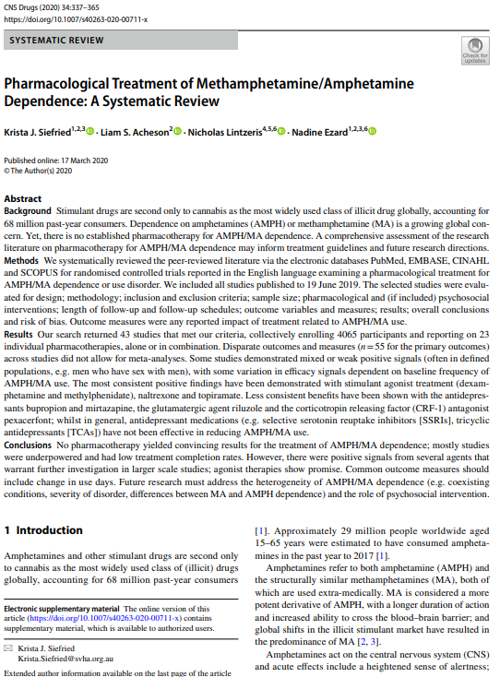

Agonist therapies for methamphetamine dependence
Agonist therapies (dexamphetamine, methylphenidate) show promise
Decrease withdrawal and cravings, increased retention
Cochrane (2013) and more recent (Siefried et al 2020) reviews highlight the need for continued research
Studies often underpowered or underdosed
Used off-label in government clinics in NSW since 2006
Siefried et al CNS Drugs 2020 34:337–365 Shearer J Subst Abuse Treat. 2007;32(1):41–52.Lee et al Drug Alcohol Rev. 2008;27(3):309-17 Baker et al; Addiction. 2001;96(9):1279-87; Hillhouse et al Addiction. 2007;96(9):84-95; Perez-Mana Cochrane 2013; Galloway GP et al.. Clin Pharmacol Ther. 2011;89(2):276–82.; Shearer J. Addiction. 2001;96(9):1289–96.
Notes:
Emerging evidence suggests that dexamphetamine may be effective in reducing cocaine use among heroin-maintained individuals [10] and a statistical trend in improving sustained cocaine abstinence has been observed in trials of dexamphetamine, modafanil and bupropion [11, 12].
Both immediate and extended release forms of dexamphetamine have been trialled as agonist-type pharmacotherapies for methamphetamine dependence [13, 14, 15, 16]. The active component dexamphetamine induces neurotransmitter release with a similar pattern to methamphetamine. Randomized controlled trials using 60 to 110 mg of dexamphetamine have shown a statistically significant decrease in amphetamine withdrawal (g ~ 0.57 to 0.62 [13, 14]) and craving (g ~ 0.59 [14]) and an increase in treatment retention (g ~ 0.72 [13, 14]). Although there was a significant decrease in methamphetamine use from baseline, the trials appear insufficiently powered to elicit a difference from placebo.

Slide 4
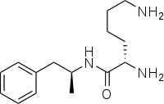
Lisdexamfetamine
Prodrug of dexamphetamine
    Licenced for use in many countries for ADHD& BED to 70mg
    Metabolised to dexamphetamine in red blood cells
    Theoretical advantages
    Contains no free dexamphetamine
    Less “abuse-related liking” IV than dexamphetamine
    Slower onset, lower peak concentration, and longer duration of action than dexamphetamine
Jasinski, D.R. and S. Krishnan, J Psychopharmacol, 2009. 23(4): p. 419-27; Heal, D.J., et al., Journal of Psychopharmacology, 2013. 27(6): p. 479-496.

Slide 5
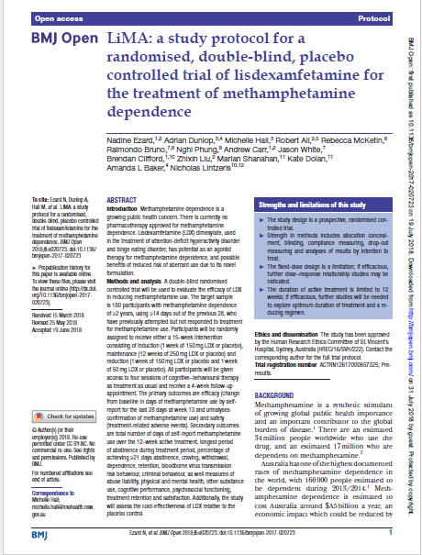
The LiMA Study
Randomised 1:1
Placebo controlled
Double blinded
Fixed dose
Multicentre
St. Vincent’s Hospital, Sydney
Drug & Alcohol Clinical Services, Newcastle
Westmead/Blacktown Hospital, Sydney
RPA Hospital, Sydney
DASSA, Adelaide, South Australia
Turning Point, Eastern Health, Melbourne
ACTRN12617000657325
HREC/16/SVH/222

Slide 6
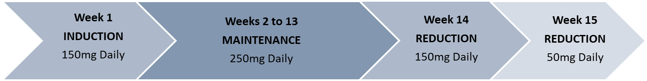
LiMA: intervention
MA use ≥ 14 days of previous 28, dependence for at least 12 months
Exclusions: Severe cardiovascular disease, untreated hypertension, peripheral vascular disease, severe psychiatric disorders.
Induction: daily attendance for 5 days, reduced to 2 days (COVID)
Maintenance: twice weekly supervised medication, reduced to once weekly (COVID)
Manualised 4 session CBT offered to all participants

Slide 7




LiMA Objectives
PRIMARY | Efficacy of oral LDX in reducing MA use
 | Safety of oral LDX
SECONDARY | Abuse liability profile
 | Changes in physical & mental health, cognitive & psychosocial functioning, wellbeing
 | Difference in retention rates
 | Difference in craving, withdrawal and SDS
 | Difference in use of other drugs of abuse
 | Difference in BBV risk behaviour (days of injecting)
 | Difference in criminality
 | Cost-effectiveness of LDX

Slide 8
Recruitment
First participant, first visit: May 2018
Last participant, last visit: December 2021
155 Participants randomised and received one dose of LDX/PBO
  97 commenced and completed prior to COVID (20 March 2020)
  21 commenced and yet to reach primary endpoint at 20th March 2020
  37 commenced with protocol changes

Slide 9
Baseline cohort – demographics
 |  | PBO | LDX | All
 |  | (n=80) | (n=75) | (N=155)
Age (years) | Median [Min, Max] | 40 [20.0, 67.0] | 38 [20.0, 68.0] | 39 [20.0, 68.0]
Gender identity | Woman | 34 (43%) | 25 (33%) | 59 (38%)
 | Man | 45 (56%) | 50 (67%) | 95 (61%)
 | Other | 1 (1%) | 0 (0%) | 1 (1%)
Sexuality & gender identity | Woman - Lesbian/homosexual | 1 (1%) | 0 (0%) | 1 (1%)
 | - Straight/heterosexual | 28 (35%) | 22 (29%) | 50 (32%)
 | Man - Gay/homosexual | 14 (18%) | 13 (17%) | 27 (17%)
 | - Straight/heterosexual | 29 (36%) | 34 (45%) | 63 (41%)
 | Other | 8 (10%) | 6 (8%) | 14 (9%)

Slide 10
Baseline cohort – social
 |  | PBO | LDX | All
 |  | (n=80) | (n=75) | (N=155)
Education | Year 10 or below | 33 (41%) | 38 (51%) | 71 (46%)
 | University Degree | 17 (21%) | 12 (16%) | 29 (19%)
Income | Full time work | 16 (20%) | 14 (19%) | 30 (19%)
 | Pension/benefit | 45 (38%) | 41 (55%) | 86 (55%)
Housing | Home owner | 8 (10%) | 19 (25%) | 27 (17%)
 | Renting - state housing | 25 (31%) | 17 (23%) | 42 (27%)
 | No usual residence/homeless* | 0 (0%) | 0 (0%) | 0 (0%)
Social support | Moderate/High ESSI** | 59 (74%) | 57 (76%) | 116 (75%)
 | Low ESSI | 21 (26%) | 18 (24%) | 39 (25%)
* Australian Treatment Outcomes Profile – 10% homeless/at risk of eviction **EnrichD Social Support Index

Slide 11
Baseline cohort – MA & Clinical
 |  | PBO | LDX | All
 |  | (N=80) | (N=75) | (N=155)
MA use (days in last 28) | Mean (SD) | 24 (4.6) | 23 (5.6) | 24 (5.1)
Severity of Dependence Scale | Mean (SD) | 10 (3.7) | 9 (3.4) | 10 (3.6)
Injecting | Proportion | 34 (43%) | 42 (56%) | 76 (49%)
Age of first use (years) | Median [range] | 21 [7 – 52] | 20 [11 – 55] | 21 [7 – 55]
Years of MA use | Median [range] | 15 [1 – 38] | 16 [2 – 38] | 16 [1 – 38]
Childhood ADHD (WURS*) | Proportion | 31 (39%) | 30 (40%) | 61 (39%)
*Wender-Utah Rating Scale for Childhood ADHD

Slide 12
Conclusion
LiMA study successfully recruited 155 participants with high levels of MA dependence and frequent use
Socially diverse sample, with high levels of disadvantage
Planned sub-group analyses for COVID cohorts, childhood ADHD and Social support groups

Slide 13

Acknowledgements
Thank you to participants, and to the anonymous client who suggested studying lisdexamfetamine for methamphetamine dependence.
Thank you to all the site study coordinators.
Funded by the National Health and Medical Research Council APP1109466, additional funding from St Vincent’s Curran Foundation and Inclusive Health Fund
NCCRED is funded by the Australian Government Department of Health and Aged Care
No relevant conflicts to declare

